Slide 1
Red wine classification using DECISION TREE
Aryan Singh B170299CS
Om Singh B170732CS

Slide 2
DECISION TREE ALGORITHM
Decision tree algorithm falls under the category of supervised learning. They can be used to solve both regression and classification problems(CART).
Regression trees are used when dependent variable is continuous.
Classification trees are used when dependent variable is categorical.
Decision tree uses the tree representation to solve the problem in which each leaf node corresponds to a class label and attributes are represented on the internal node of the tree.

Slide 3
DECISION TREE algorithm pseudocode
Place the best attribute of the dataset at the root of the tree.
Split the training set into subsets. Subsets should be made in such a way that each subset contains data with the same value for an attribute.
Repeat step 1 and step 2 on each subset until you find leaf nodes in all the branches of the tree.

Slide 4
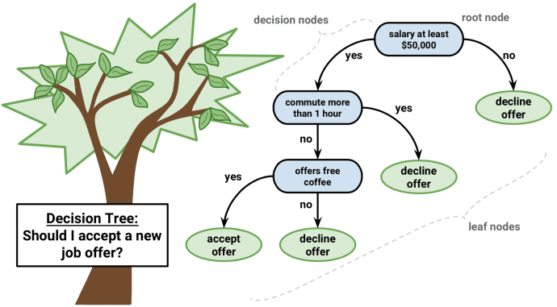

Slide 5
Prediction
In decision trees, for predicting a class label for a record we start from the root of the tree. We compare the values of the root attribute with record’s attribute. On the basis of comparison, we follow the branch corresponding to that value and jump to the next node. We continue comparing our record’s attribute values with other internal nodes of the tree until we reach a leaf node with predicted class value.

Slide 6
Our Implementation
Step 1: Firstly we imported the required libraries and loaded the wine quality dataset.
Step 2: We did the exploratory data analysis to learn the correlations of dependent variable on independent variable which we will cover during live presentation.
Step 3: We made two categories of wine based on the quality.
Those data points where quality <= 5, we encoded it as bad.
And where quality > 5, we encoded it as good.
Step 4: We created the training set and test set by random sampling and trained our model using decision tree algorithm to classify each of the wine as good or bad.

Slide 7
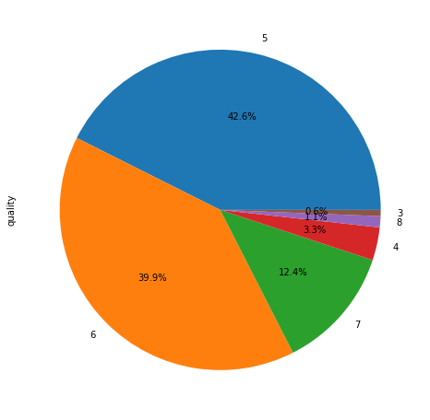
Graphs and correlations

Slide 8
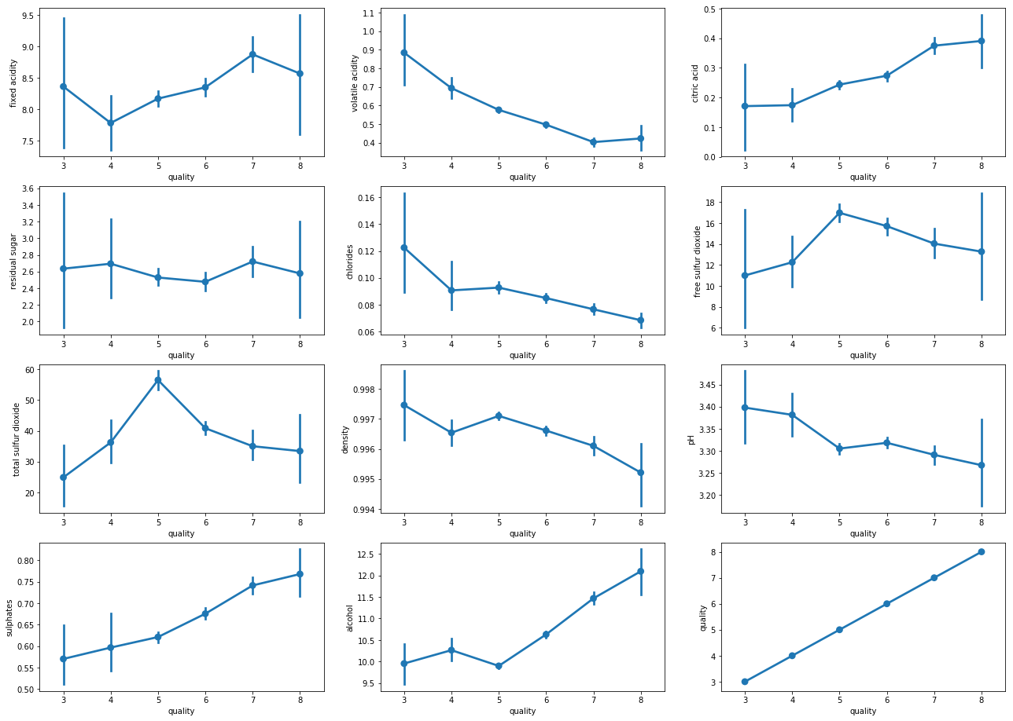

Slide 9
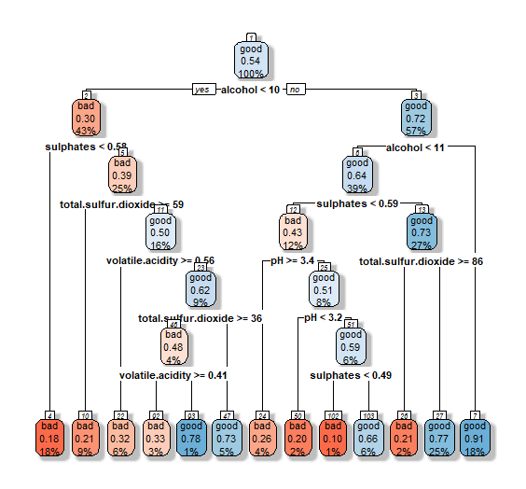

Slide 10
THANK YOU

